Slide 1
Collaboration Diagram

Slide 2
In UML a Collaboration Diagram is a type of Interaction Diagram that visualizes the interactions and relationships between objects in a system. It shows how objects collaborate to achieve a specific task or behavior. Collaboration diagrams are used to model the dynamic behavior of a system and illustrate the flow of messages between objects during a particular scenario or use case.

Slide 3
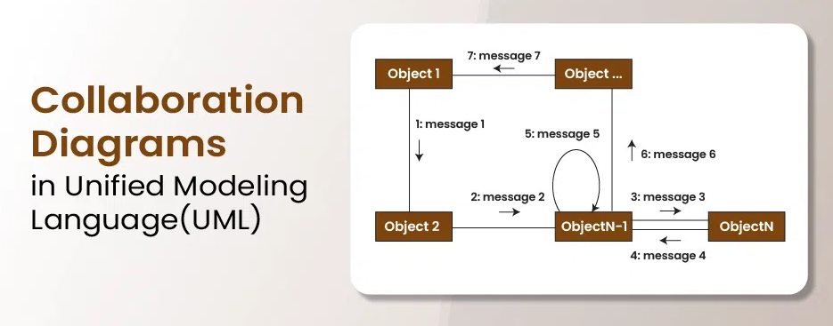

Slide 4
Components and their Notations in Collaboration Diagrams
Objects/Participants
Objects are represented by rectangles with the object’s name at the top. Each object participating in the interaction is shown as a separate rectangle in the diagram. Objects are connected by lines to indicate messages being passed between them.

Slide 5
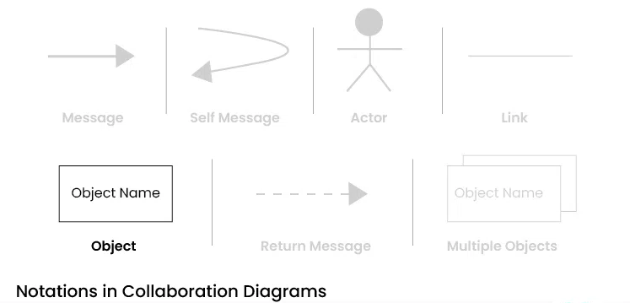
Objects/Participants

Slide 6
Multiple Objects
Multiple objects are represented by rectangles, each with the object’s name inside, and interactions between them are shown using arrows to indicate message flows.

Slide 7
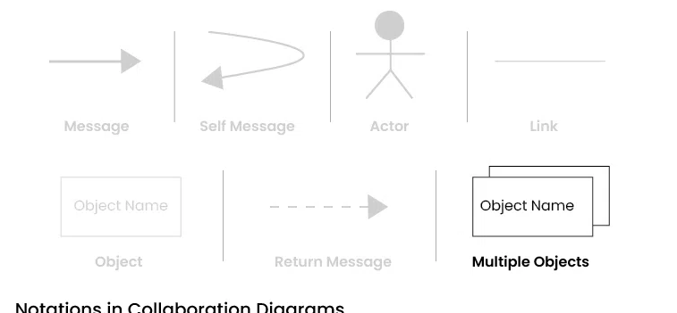
Multiple Objects

Slide 8
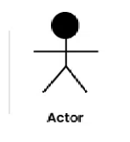
Actors
They are usually depicted at the top or side of the diagram, indicating their involvement in the interactions with the system’s objects or components. They are connected to objects through messages, showing the communication with the system.

Slide 9
Messages
Messages represent communication between objects. Messages are shown as arrows between objects, indicating the flow of communication. Each message may include a label indicating the type of message (e.g., method call, signal). Messages can be asynchronous (indicated by a dashed arrow) or synchronous (solid arrow).

Slide 10
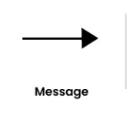

Slide 11
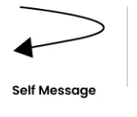
Self Message
Self Message
This is a message that an object sends to itself. It represents an action or behavior that the object performs internally, without involving any other objects. Self-messages are useful for modeling scenarios where an object triggers its own methods or processes.

Slide 12
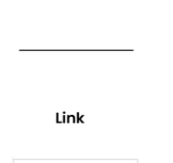
Links
Links represent associations or relationships between objects. Links are shown as lines connecting objects, with optional labels to indicate the nature of the relationship. Links can be uni-directional or bi-directional, depending on the nature of the association.

Slide 13
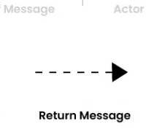
Return Messages
Return messages represent the return value of a message. They are shown as dashed arrows with a label indicating the return value. Return messages are used to indicate that a message has been processed and a response is being sent back to the calling object.

